Slide 2
PENS
Pick a formula. (SV)
Explore words to fit the formula.
Note the words.
Search and check.

Slide 3
MARK
M
Ask ”Is there a verb?"
Root out the subject
(ask, ”Who or What _____?")
Key in on the
beginning
ending
meaning

Slide 4
Snow fluffy.

Slide 5
Snow is fluffy.

Slide 6
Linking Verbs
Words that link the subject to another word that describes the subject.
Am
Are
Was
Were
Is

Slide 7
LINKS

Slide 9
Snow
is
fluffy.

Slide 10
I
am
tired.

Slide 11
The cats
are
funny.

Slide 12
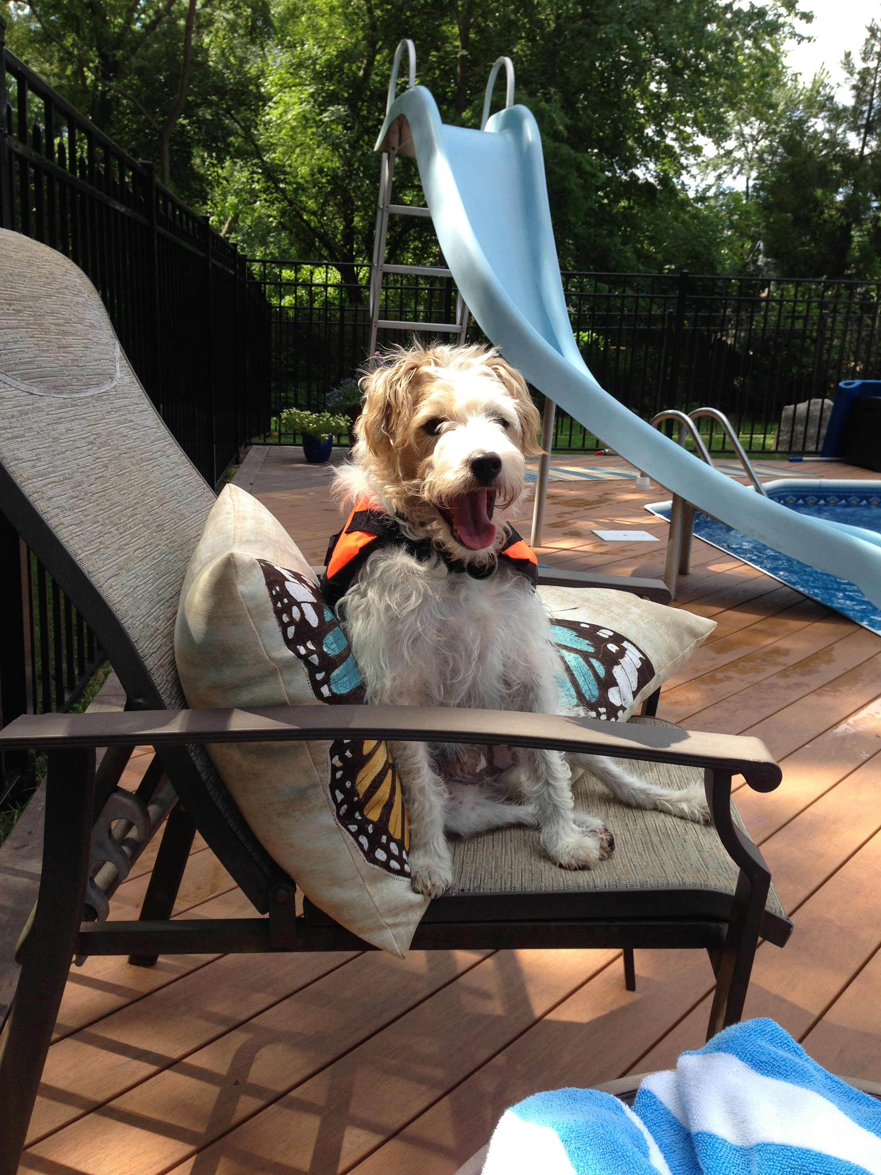
PENS

Slide 13
S
V
.
Buddy is adorable

Slide 15
