Slide 2
Today is M Day!

Slide 3
PENS
Pick a formula. (SV)
Explore words to fit the formula.
Note the words.
Search and check.

Slide 4
MARK
M
Ask ”Is there a verb?"
Root out the subject
(ask, ”Who or What _____?")
Key in on the
beginning
ending
meaning

Slide 5
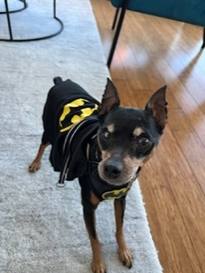
This is Batman!

Slide 6
The Imposters
Imposter number one is an Infinitive. Since it has a verb in it, it tries to trick you into thinking it is the verb of the sentence.

Slide 7
Infinitives
to + a verb
Examples:
to run to eat to fly

Slide 8
Let’s name some infinitives.
I like to cook dinner.
I need to clean my room.
I want to read a good book.
What do you like to do or want to do or need to do?

Slide 9
MARK
Mark out imposters
infinitives
Ask “Is there a verb?”
Root out the subject
(“Who or What _____?”)
Key in on the
beginning
ending
meaning

Slide 10
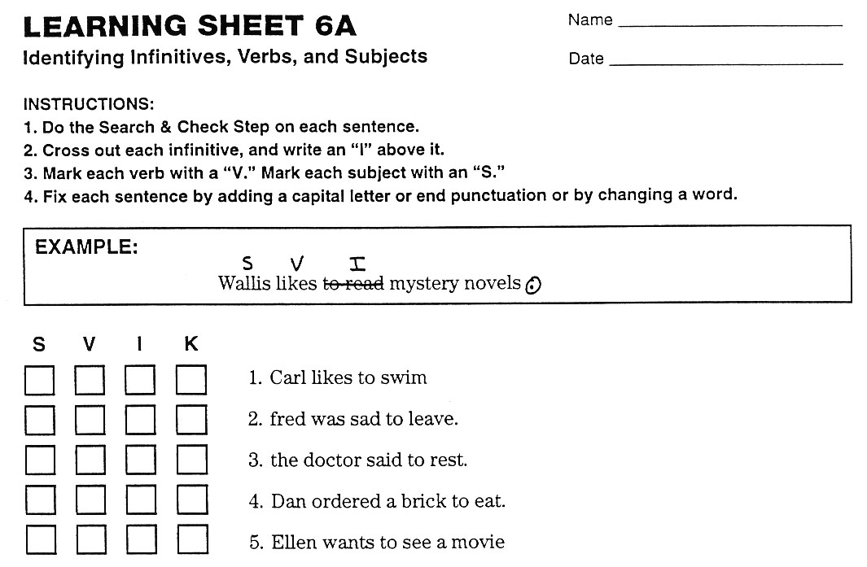

Slide 11
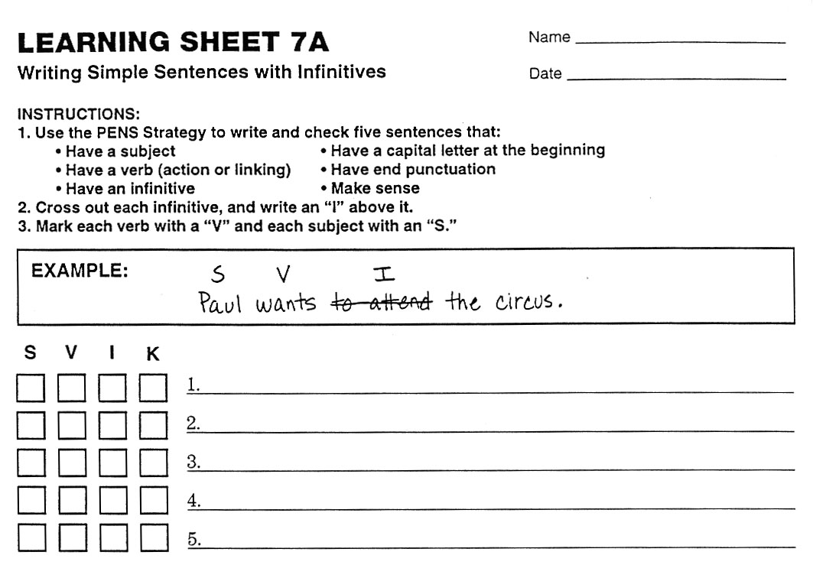
Like
Love
Need
Try
Plan

