Slide 2
PENS
Pick a formula. (SV)
Explore words to fit the formula.
Note the words.
Search and check.

Slide 3
MARK
Mark out the imposters
Infinitives
??????
Ask ”Is there a verb?"
Root out the subject
(ask, ”Who or What _____?")
Key in on the
beginning
ending
meaning

Slide 4
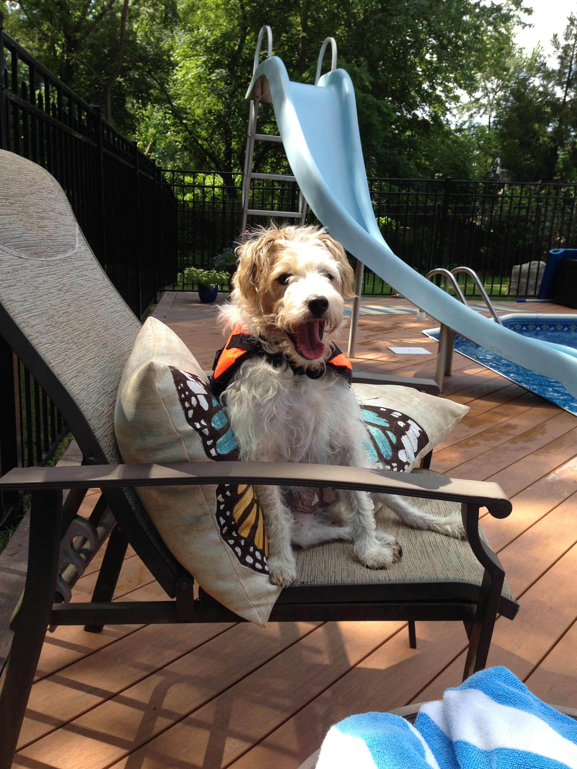

Slide 5
S
S
Buddy sits on the chair.

Slide 6
MARK
Mark out the imposters
Infinitives
Ask ”Is there a verb?"
Root out the subject
(ask, ”Who or What _____?")
Key in on the
beginning
ending
meaning
Prepositional Phrases

Slide 8
Where would you hide if there were a monster in your house?

Slide 10
S
V
P
Buddy sits on the chair.

Slide 11
During the morning, Buddy sits on the chair by the pool in the sun.

Slide 12
Let’s use PENS and MARK to write and check sentences with prepositional phrases.

Slide 14
I hid in my closet.
Joey played with his friends.

