Slide 1
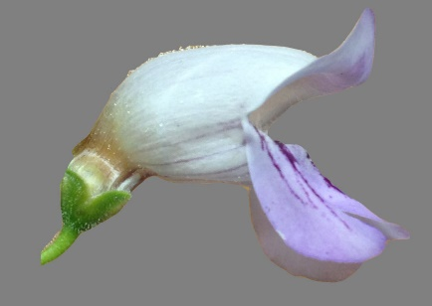

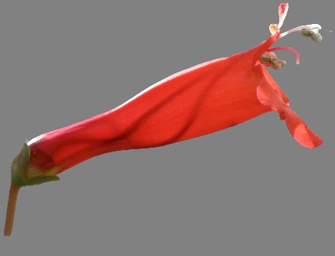
Lena C. Hileman, professor
Ecology & Evolutionary Biology
Evolution and Development of Flower Form
Impact and Achievements
Kavli Fellow: National Academy of Sciences
Thirty invited seminars at national and international venues
NSF Dimensions of Biodiversity grant and other NSF funding
Mentoring and Student Learning Opportunities
Provides independent research training in her courses
Mentors students while conducting research with a focus on underrepresented groups in STEM
Received Office for Diversity on Science Training Undergraduate Mentor Recognition Award
Evolutionary shifts in pollinator adaptation: from bee-adapted (top) to hummingbird-adapted (bottom)
More Information: https://eeb.ku.edu/lena-hileman

