Slide 1

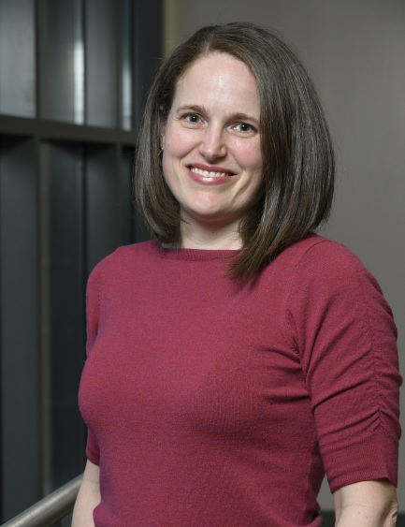

POLITICAL SCIENCE DEPARTMENT,
GUEST SPEAKER
Sarah Allen Gershon
“Gender Differences in Emotional Reactions to the 2016 Presidential Debates”
Thursday, March 28
4:00 p.m.
Malott Room, Union
Associate Professor of Political Science at Georgia State University.
Her research focuses on political incorporation of traditionally under-represented groups (women and racial/ethnic minorities).
KU is an EO/AA institution.

